Slide 1
Testing if we can drop strongly correlated features

Slide 2
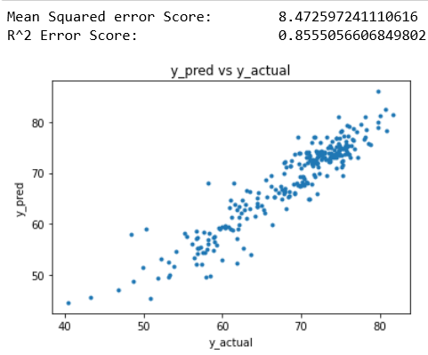
Before ( with everything (Not including Measles)

Slide 3
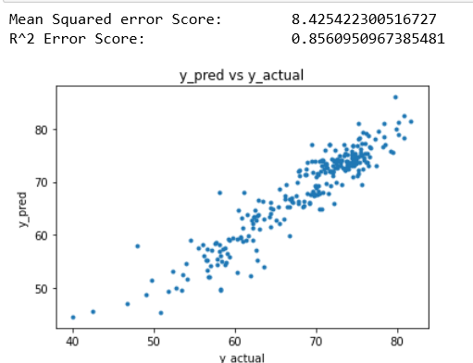
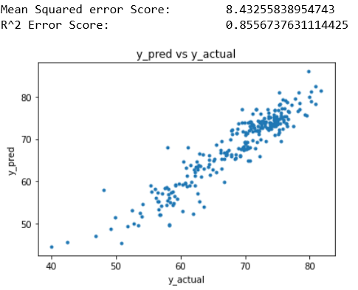
w/o infant deaths w/o under-five deaths

Slide 4
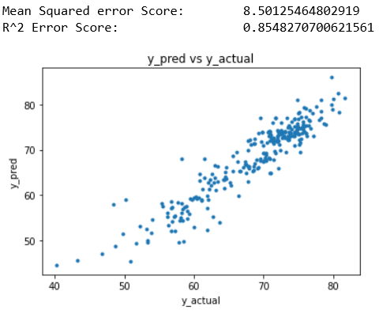
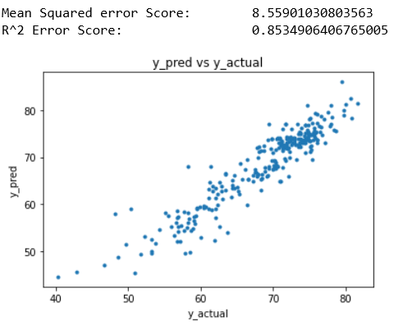
w/o thinness 1-19 years w/o thinness 5-9 years

Slide 5

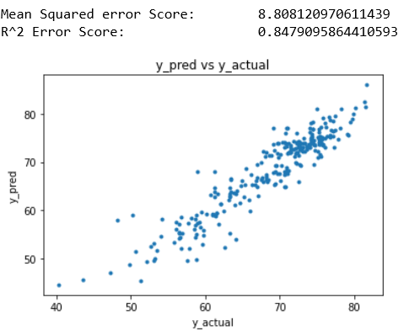
w/o Income composition of resources w/o Schooling

